Slide 1
Social Networks
May 2024

Slide 2
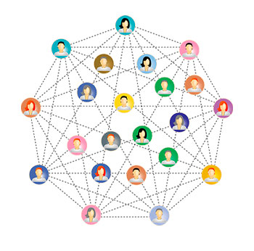
Definition
Social network is a connection of individuals or groups connected by some relations. Members of a family form a network (family network), some farmers in a village form a farmer network, some businessmen form a business network. A million of people are using smart phones and they are very comfort to use social app to connect each other and share information to each other. Recently online social networks like Twitter, Facebook and LinkedIn have grown extremely popular in human life. Individuals, colleagues, organizations, etc. are attached to each other within the social network.

Slide 3
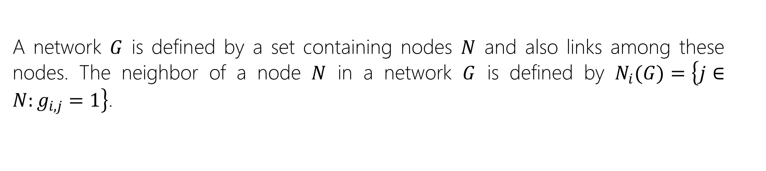
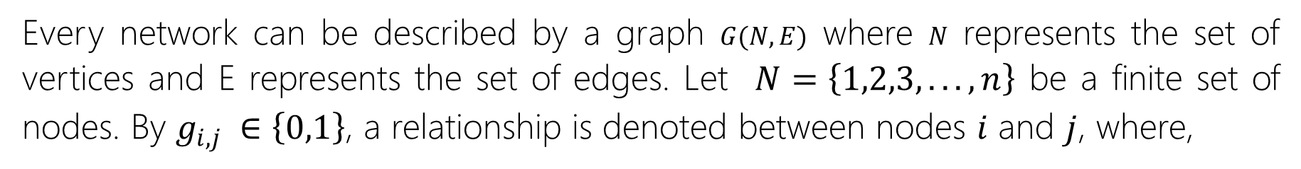
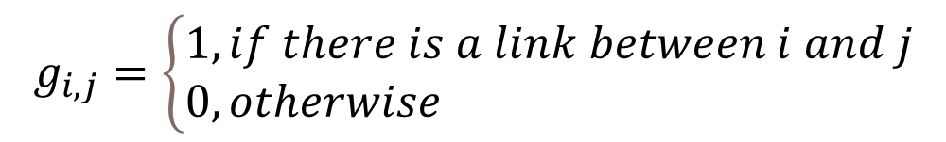
Basic concepts
Every network can be described by a graph $G(N,E)$ where $N$ represents the set of vertices and E represents the set of edges. Let $N=\left\{1,2,3,...,n\right\}$ be a finite set of nodes. By $g_{i,j} ∈\left\{0,1\right\}$, a relationship is denoted between nodes $i$ and $j$, where,
$$g_{i,j}=\left\{\begin{aligned}&1, if there is a link between i and j \\ &0, otherwise\end{aligned}\right.$$
A network $G$ is defined by a set containing nodes $N$ and also links among these nodes. The neighbor of a node $N$ in a network $G$ is defined by $N_{i}(G)=\left\{j∈N:g_{i,j}=1\right\}$.

Slide 4
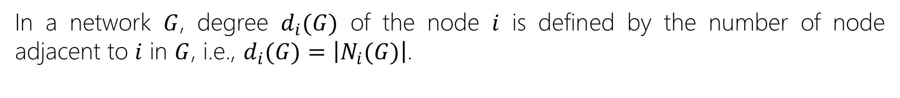



Basic concepts
In a network $G$, degree $d_{i}(G)$ of the node $i$ is defined by the number of node adjacent to $i$ in $G$, i.e., $d_{i}(G)=\left|N_{i}(G)\right|$.
$$i$$
The geodesic distance $d(i,j)$ from the node $i$ to the node $j$ is given by $d(i,j)$ = the number of links in a shortest path to node $j$ from node $i$, if path exists.
$$i$$
$$j$$

Slide 5





Basic concepts
Path among every two nodes within a network, if exists, then the network is called connected network.
A network is called directed network if the nodes connected by links having direction associated to each link.
$$i$$
$$i$$
$$k$$
$$i$$
$$j$$

Slide 6

Basic concepts
A network is called weighted network if the edges among the nodes have weights.
163
251
$$i$$
132
423

Slide 7

Centrality measures
Centrality measures can be remarked as a mathematical tool applied in the social network analysis to identify important element in the network.
Degree centrality of a node is a number that indicates the number of nodes directly linked to this node,
$$d_{i}(G)=\left|N_{i}(G)\right|$$
The closeness centrality measure is defined as inverse of sum of geodesic distances to every other vertices from each vertex within the network,
$$C_{i}\left(G\right)=\frac{1}{\underset{j∈N}{\sum{d}(i,j)}}$$

Slide 8
Caso de Estudio
Una empresa de servicios financieros “X” sospecha de posible fraude entre sus agentes de ventas. Los clientes se mueven hacia la competencia y regresan a la empresa “X” cuantas veces lo deseen. Estos movimientos son influenciados completamente por los agentes de ventas. Cada vez que un cliente nuevo ingresa a la compañía “X” el agente de venta relacionado recibe una comisión. Del mismo modo ocurre cuando el cliente entra por segunda, tercera o n vez a la compañía “X”. La hipótesis de la empresa “X” es que los agentes están moviendo a los clientes con el único objetivo de ganar comisión en ciclos de entradas y salidas.

Slide 9
Questions?

